Slide 1
Advanced Placement African American Studies

Slide 2
What is in this presentation?
01
Overview of AP African American Studies
02
Course Framework Overview
03
Eliciting Course Skills
04
Summative vs. Formative Assessment
05
P2 AP African American Studies Exam Structure

Slide 3
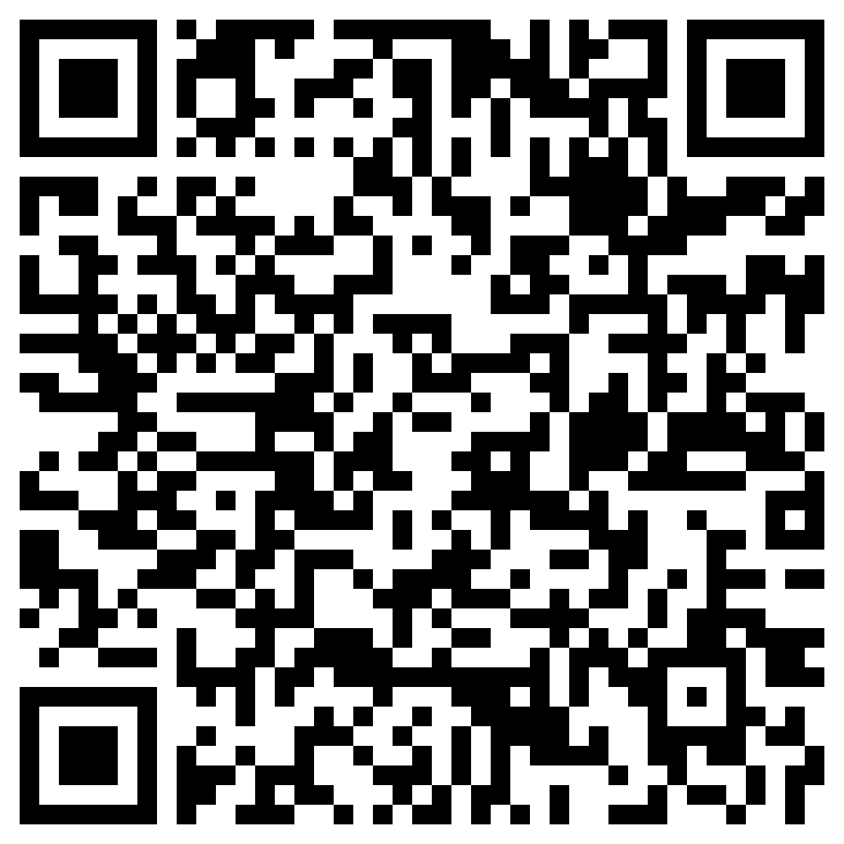
Overview of AP African American Studies
1
Cover Page

Slide 4
AP African American Studies Timeline
Course research and design completed
Course framework and exam design completed
Launch inaugural Development Committee to build course and exam resources
Secure higher Ed credit policy commitments
Pilot year 1: Focus on course framework and exam learning
Pilot year 2: Focus on instructional resources and teacher support learning
Course launch at scale
Fall 2024
Fall 2023
Fall 2022
June 2022
Early 2022
2021
Notes:
BW

Slide 5
Course Rationale
Strong interest from high school teachers, students, and administrators
Confidence in Higher Ed acceptance vis-à-vis course credit and placement
Likely to attract a more diverse AP student body
Continues our investment in strengthening the culturally inclusive nature of AP courses
Notes:
BW

Slide 6
Course Research and Design Inputs
Syllabi Review
100+ college syllabi, including 11 HBCUs, all 8 Ivies, and 26 state flagship institutions
Winter 2021
High School Insights
High school teacher and administrator focus groups and review of curriculum guides/syllabi
Summer 2021
College faculty content survey
Clarifying and confirming guidance received during the focus groups
Higher Ed Focus Groups
Conversations with 133 college faculty about the scope of the course, instructional resources, and plans for teacher training
Spring 2021
Higher Ed Advisory Sessions
Four in-depth panel sessions with ~50 college faculty about proposed course units and topics
Fall 2021
Advisory Board and Writing Team
Scholars and teachers helped shape the overarching vision of the course and draft models of the course framework
Summer 2021
Disciplinary Organizations, Advocacy Groups, and Luminaries
Outreach conversations with organizations including ASALH, ASWAD, NMAAHC, and GLI to gather input, expand instructional and professional learning resources, and build a coalition of support
Ongoing
Pilot teacher feedback: July – December 2022
Notes:
BW

Slide 7
About AP African American Studies
The course focuses on four thematic units that move across the instructional year chronologically, providing students opportunities to delve into key topics that extend from early African societies to the ongoing challenges and achievements of the contemporary moment. Given the multidisciplinary character of African American Studies, students in the course will develop skills across multiple disciplines, with an emphasis on developing historical, literary, visual, and data analysis skills. The new course will also foreground a study of the diversity of Black communities in the United States within the broader context of Africa and the African Diaspora.

Slide 8
Course design priorities
Principle | Guidance
Focus | The course framework should promote depth and focus by including the most important and essential topics. Thematic units should follow a chronological structure to support student understanding and ease of implementation.
Interdisciplinarity | Each unit should foster interdisciplinary analysis, with specific disciplines identified (e.g. history, literature, arts, social sciences) and recurring across the course.
Source analysis | Careful curation of texts and sources should provide students direct and deep encounters with historical, cultural, and intellectual developments across multiple perspectives.
Core concepts | Students should understand core concepts, including diaspora, the struggle for civil rights, the language of race and racism (e.g. structural racism, racial formation, racial capitalism, etc.) and be introduced to important approaches (e.g. Pan-Africanism, Afro-futurism).
Situating Africa | Students should understand the complexity of African cultures as the foundation of the diversity of the African diaspora. They should learn about the ongoing relationship between Africa and the US/Diaspora throughout the course (not just during the period of enslavement) as constitutive of Black identities, Black thought, and the field of Black Studies.
Professional learning | The AP program should dedicate significant time and resources to building a robust suite of professional learning resources that leverages partnerships with higher education institutions and provides all teachers with the tools they need to teach this course well.
Notes:
BW

Slide 9
AP African American Studies Learning Outcomes
Apply lenses from multiple disciplines to evaluate key concepts, historical developments, and processes that have shaped Black experiences and debates within the field of African American Studies.
Identify connections between Black communities in the United States and the broader African Diaspora in the past and present.
Analyze perspectives in text-based, data, and visual sources to develop well-supported arguments applied to real-world problems.
Demonstrate the understanding of the diversity, strength, and complexity of early African societies and their global connections before emergence of transatlantic slavery.
Evaluate the political, historical, aesthetic, and transnational contexts of major social movements, including their past, present, and future implications.
Develop a capacious understanding of the many strategies African American communities have employed to represent themselves authentically, promote advancement, and combat the effects of inequality and systemic marginalization locally and abroad.
Identify major themes that inform literary and artistic traditions of the African Diaspora.

Slide 10
Assessing Student Progress and Understanding
African American Studies
Assessments should be aligned to the content and skills of the AP African American Studies Course Framework and evaluate student understanding of concepts they have had opportunity to explore thoroughly.
Formative assessments allow teachers to check student understanding of course content and skills after each topic and unit to identify areas where students may need additional targeted instruction.
Meaningful feedback enables students to better understand their areas of strength and areas where they may need additional support.

Slide 11
Course Framework Overview
2
Cover Page

Slide 12
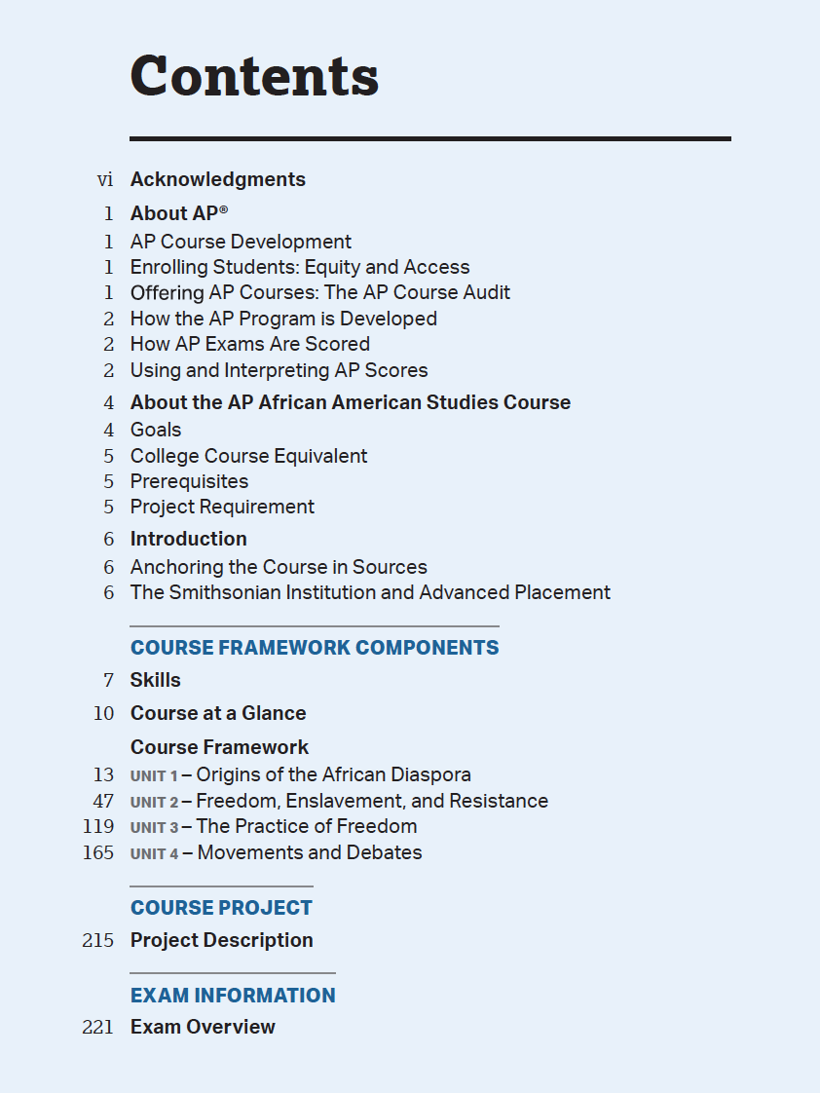
Course Framework

Slide 13
About the AP African American Studies Course
AP African American Studies is an interdisciplinary course that examines the diversity of African American experiences through direct encounters with authentic and varied sources. Students explore key topics that extend from early African kingdoms to the ongoing challenges and achievements of the contemporary moment. Given the interdisciplinary character of African American studies, students in the course will develop skills across multiple fields, with an emphasis on developing historical, literary, visual, and data analysis skills. This course foregrounds a study of the diversity of Black communities in the United States within the broader context of Africa and the African diaspora.

Slide 14
Course Goals
Throughout this course, students will learn to:
Apply lenses from multiple disciplines to evaluate key concepts, historical developments, and processes that have shaped Black experiences and debates within the field of African American studies.
Identify connections between Black communities in the United States and the broader African diaspora in the past and present.
Compare and analyze a range of perspectives about the movements, approaches, organizations, and key figures involved in freedom movements, as expressed in textbased, data, and visual sources.
Demonstrate understanding of the diversity and complexity of African societies and their global connections before the emergence of transatlantic slavery.
Evaluate the political, historical, aesthetic, and transnational contexts of major social movements.
Develop a broad understanding of the many strategies African American communities have employed to represent themselves authentically, promote advancement, and combat the effects of inequality.
Identify major themes that inform literary and artistic traditions of the African diaspora.

Slide 15
Course Framework Components
SKILLS The skills are central to the study and practice of African American studies. Students should practice and develop the described skills on a regular basis over the span of the course.
UNITS
The required course content is organized within four thematic units that move across the instructional year chronologically. These units have been designed to occupy 28 weeks of a school year; schools offering this course in a single semester will need 14 weeks of double periods, or the equivalent amount of instructional time. Each unit is composed of a variety of topics.
TOPICS
Each topic typically requires 1-2 class periods of instruction. Teachers are not obligated to teach the topics in the suggested sequence listed in each unit, but to receive authorization to label this course “Advanced Placement,” all topics must be included in the course.

Slide 16
Skill Category 1 | Skill Category 2 | Skill Category 3
Applying Disciplinary Knowledge | Source Analysis | Argumentation
Explain course concepts, developments, patterns, and processes (e.g., cultural, historical, political, social). | Evaluate written and visual sources, and data (including historical documents, literary texts, music lyrics, works of art, material culture, maps, tables, charts, graphs, and surveys). | Develop an argument using a line of reasoning to connect claims and evidence.
1A Identify and explain course concepts, developments, and processes.
1B Identify and explain the context of a specific event, development, or process.
1C Identify and explain patterns, connections, or other relationships (causation, changes, continuities, comparison).
1D Explain how course concepts, developments, and processes relate to the discipline of African American studies.
2A Identify and explain a source’s claim(s), evidence, and reasoning.
2B Describe a source’s perspective, purpose, context, and audience.
2C Explain the significance of a source’s perspective, purpose, context, and audience.
2D Describe and draw conclusions from patterns, trends, and limitations in data, making connections to relevant course content.
3A Formulate a defensible claim.
3B Support a claim or argument using specific and relevant evidence.
3C Strategically select sources—evaluating the credibility of the evidence they present—to effectively support a claim.
3D Select and consistently apply an appropriate citation style.
3E Use a line of reasoning to develop a well-supported argument.
Notes:
Page 9 in CF

Slide 17
Course at a Glance: Units
Unit 1
Origins of the African Diaspora
Unit 2
Freedom, Enslavement, and Resistance
Unit 3
The Practice of Freedom
Unit 4
Movements and Debates
Notes:
BW

Slide 18
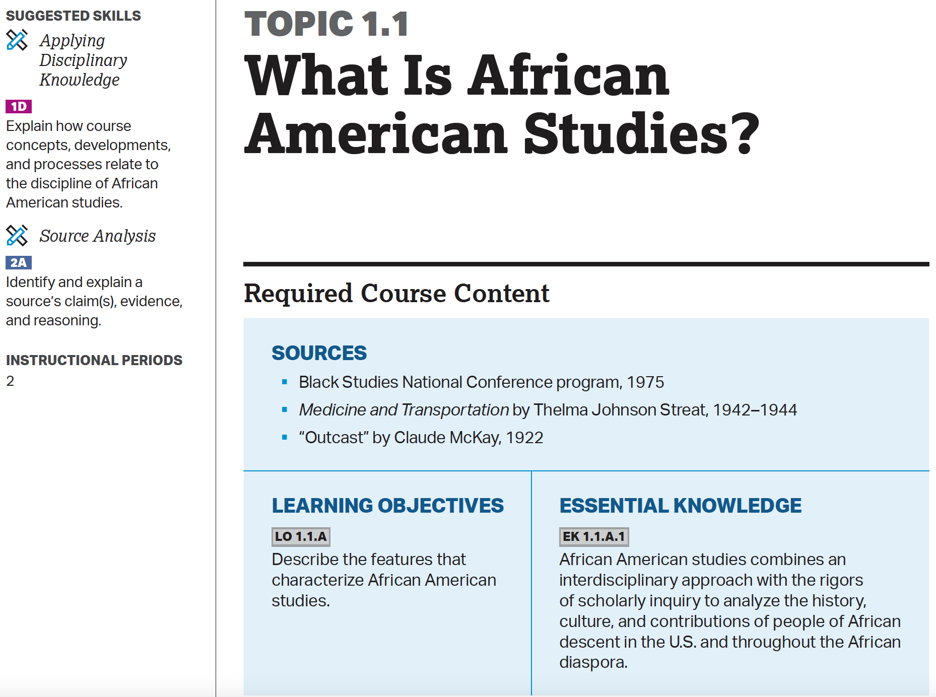

Slide 19
TOPICS
Each topic contains three required components:
Required Sources: College-level coursework in African American studies requires that students engage directly with sources from a variety of disciplines – works of art and music, sociological data, historical records, and so on. The source encounters embedded in each topic are required and have been curated to help focus and guide instruction. Schools are responsible for making these sources available to each student in the course.
Learning Objectives: These statements indicate what a student must know and be able to do after learning the topic. Learning objectives pair skills with content knowledge.
Essential Knowledge: Essential knowledge statements comprise the content knowledge required to demonstrate mastery of the learning objective. These statements provide the level of detail that may appear within AP exam questions about the topic.
Teachers should utilize these three required components to develop daily lesson plans for this course. In addition, for some topics several non-required components are included as additional supports for lesson planning and instruction:
Source Notes: While not part of the AP exam, these notes provide teachers with broader context for the topic and required sources, which may be useful for illustrating the topic or for preventing misunderstandings.

Slide 20
Eliciting Course Skills
3
Cover Page

Slide 21
Skill Category 1 | Skill Category 2 | Skill Category 3
Applying Disciplinary Knowledge | Source Analysis | Argumentation
Explain course concepts, developments, patterns, and processes (e.g., cultural, historical, political, social). | Evaluate written and visual sources, and data (including historical documents, literary texts, music lyrics, works of art, material culture, maps, tables, charts, graphs, and surveys). | Develop an argument using a line of reasoning to connect claims and evidence.
1A Identify and explain course concepts, developments, and processes.
1B Identify and explain the context of a specific event, development, or process.
1C Identify and explain patterns, connections, or other relationships (causation, changes, continuities, comparison).
1D Explain how course concepts, developments, and processes relate to the discipline of African American studies.
2A Identify and explain a source’s claim(s), evidence, and reasoning.
2B Describe a source’s perspective, purpose, context, and audience.
2C Explain the significance of a source’s perspective, purpose, context, and audience.
2D Describe and draw conclusions from patterns, trends, and limitations in data, making connections to relevant course content.
3A Formulate a defensible claim.
3B Support a claim or argument using specific and relevant evidence.
3C Strategically select sources—evaluating the credibility of the evidence they present—to effectively support a claim.
3D Select and consistently apply an appropriate citation style.
3E Use a line of reasoning to develop a well-supported argument.
Page 9

Slide 22
Summative vs. Formative Assessment
4
Cover Page

Slide 23
Comparing Formative and Summative Assessments
Formative
Assessments
Summative
Assessments
Designed to be used in real-time as part of the instructional cycle
Designed to capture the accumulation of a student’s knowledge at the end of a particular instructional cycle
Include timely feedback or follow-up instruction that helps a student learn and improve
Usually culminating experiences that only report a final “score” (like the AP Exam)
Provide opportunities to practice in a low-stakes setting and provide feedback to help students improve
Often formal, high-stakes, and provide little opportunity for feedback

Slide 24
P2 AP African American Studies Exam Structure and College Placement
5
Cover Page

Slide 25
Exam Overview:
The AP African American Studies Exam assesses student understanding of the skills and learning objectives outlined in the course framework. The end of course exam is 2 hours 30 minutes long and includes 60 multiple-choice questions and 4 free-response questions. In addition to the end of course exam, the course includes a project that students will submit prior to the end of course exam. The details of the exam can be found below:
Section |  | Time
1 | 60 Multiple Choice-Questions | 20 minutes
2 | Free-response question 1 Text-based source | 20 minutes | 80 minutes
 | Free-response question 2 Non-text source | 20 minutes
 | Free-response question 3 (no source) | 20 minutes
 | Free-response question 4 | 20 minutes
 | Project: written argument | 3 instructional weeks
Notes:
Overview

Slide 26
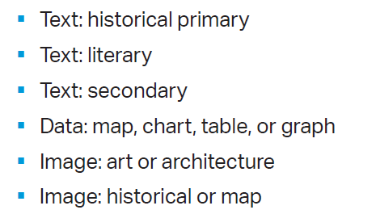
Multiple Choice Questions
60 Multiple Choice Questions-70 minutes
Appear in sets of 3-4 questions
Each set includes one or two sources which serve as stimulus material for the questions in the set.
Notes:
Multiple Choice

Slide 27
Multiple Choice
Course Framework Connections
Topic 3.17 The Great Migration
LO 3.17.A Describe the causes of the Great Migration
EK 3.17.A.1 The Great Migration was one of the largest internal migrations in U.S. history. Six million African Americans relocated in waves from the South to the North, Midwest, and western United States from the 1910s to 1970s.
Skill 2B Describe a source’s perspective, purpose, context, and audience.
Difficulty- Emerging/Proficient
Multiple Choice Questions directly align to the course framework.
Every question is connected to a topic Learning Objective and Essential Knowledge Statement.
Each question is aligned to a course skill.
Notes:
Multiple Choice

Slide 28
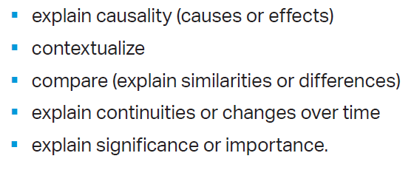
Free-response Questions
4 free-response questions-80 minutes
4 free response questions consisting of four to five question parts per question
Questions 1 & 2 are source-based questions
One is a text-based source
One in a non-text source
Questions 3 & 4 no source
Based on broad thematic concepts the recurs throughout course units
First two questions parts will ask students to provide examples related to thematic concepts
Next two questions parts will ask students to do one or more of the following:
Notes:
Free Response

Slide 29
Project
Research paper | Written argument
The course project provides students with an opportunity to research any topic, theme, issue, or development in the field of African American studies.
Students will define a research topic and line of inquiry, conduct independent research to analyze primary and secondary sources from multiple disciplines, and develop an evidence based written argument of 1200-1500 words.
Students will have at least 3 weeks to work on the research paper in class with their teachers assistance.
Notes:
Project Overview

Slide 30
College Placement
Will students get college credit like all other AP classes?
Currently over 200 schools have confirmed that they will give students college credit for AP African American Studies.
The list of schools will be posted on the College Board’s website in the Fall of 2024.

