Slide 1
HOW TO PAY FOR COLLEGE Northern Virginia Community College
admissions@nvcc.edu

Slide 2
What Does it Cost to Go to College?
TUITION: the cost of attending classes only
OTHER EXPENSES
Fees
Technology fees, student activity fees, etc.
Room & Board
(4-year schools) – the cost to live on campus, plus a meal plan
Books
$500-$600/ semester
Supplies
Transportation
Parking permits
Personal Expenses
https://collegecost.ed.gov/net-price

Slide 3
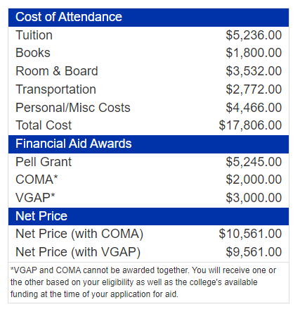
Net Cost
Assumptions:
EFC $1000
High School GPA 3.0

Slide 4
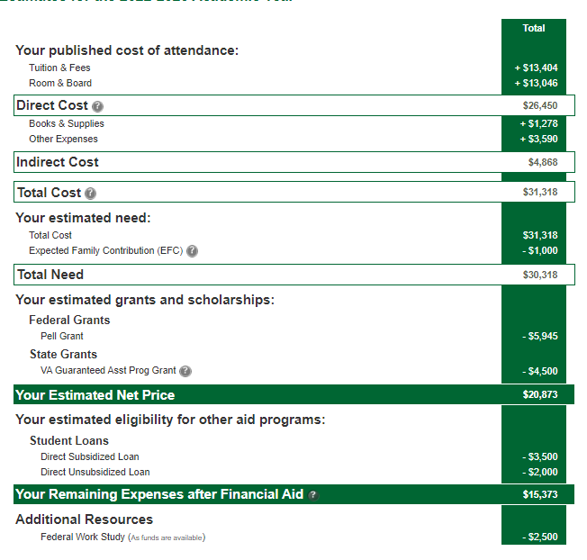
George Mason University

Slide 5
HOW WILL YOU PAY FOR COLLEGE?
GRANTS (need based)
Federal Pell Grant
State Grants
Institutional Grants
SCHOLARSHIPS (merit or need based)
Institutional
Private
LOANS
Subsidized
Unsubsidized
Work Study
VETERANS BENEFITS
529 PLANS
Out-of-Pocket
Some schools offers payment plans to break up your total balance into smaller portions paid over a set amount of time

Slide 6
Grants
A Grant is money that is given to you based on financial need that does not need to be paid back.
Federal Pell Grant
Accessed through the FAFSA
Maximum amount is $6,895 for the 2022–23 award year
State Grants
Need based aid from the state
Accessed through the FAFSA or VASA
Virginia Commonwealth Award, Virginia Guaranteed Assistance Program (VGAP), Virginia Tuition Assistance Grant (VTAG)
Institutional Grants
Need based aid given by the college
Accessed through FAFSA or VASA
Northern Virginia Community College Tuition Assistance Grant (NOVA TAG)
Virginia Community College System Tuition Grant

Slide 7
Scholarships
A scholarship is a form of financial aid awarded to students that does not need to be paid back. Generally, scholarships are awarded based on a set of criterial such as academic merit, athletic skill, financial need, etc.
Private
Awarded by an outside intuition to be used at any college you choose.
May be merit or need based
Requires an application
Institutional
Awarded by the College you are attending to be used at that college
May be merit or need based
May or may not require an application
NOVA Scholarships
Apply here: https://nvcc.academicworks.com/
Scholarship Application Periods for the 2023 – 2024 Academic Year
(Scholarships will be awarded for 2023 – 2024 enrollment, which begins with the Fall 2023 semester).
Spring 2023 Cycle: January 17, 2023 – February 17, 2023
Summer 2023 Cycle: May 8, 2023 – May 29, 2023
Fall 2023 Cycle: August 28, 2023 – September 29, 2023

Slide 8
Loans
A student loan is a type of loan designed to help students pay for post-secondary education and the associated fees, such as tuition, books and supplies, and living expenses. Loans must be paid back with interest.
Types of Federal Student Loans
Subsidized Loans
Unsubsidized Loans
Plus Loans
Grad Students or Parents of Undergrad Students
Consolidation Loans
Subsidized Loans
Accessed through the FAFSA
Need based
Lowest interest rate
Federal government pays the interest while you are in college
A student enters repayment - After graduation, leave school, or drop below half-time enrollment. After this point the student has 6 months to start payments.
Unsubsidized Loans
Accessed through the FAFSA
Not need based
Higher interest rate
Federal government does NOT pay the interest.
Repayment is the same as the Subsidized Loan

Slide 9
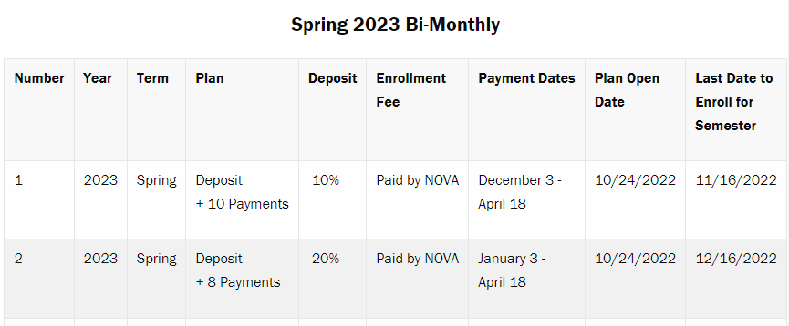
Payment Plans @ NOVA
NOVA’s Payment Plan makes tuition manageable. By entering the Payment Plan earlier, your tuition cost is spread over a longer period and your payments are lower.
NOVA offers several payment plans to meet your needs
The deposit amount, payment amount, and number of payments is dependent on the date of enrollment in the plan. Plans can be:
Monthly
Bi-monthly

Slide 10
What is the FAFSA
FAFSA = FREE Application for Federal Student Aid https://studentaid.gov
Determines eligibility for many of the types of need-based aid that we have already talked about.
FAFSA determines financial need by looking at…
Prior-prior year income and Financial Assets
Current Household Size
Number of family members attending college
Students starting Aug 2023 should complete the 2023/2024 FAFSA, using their 2021 taxes*
*If your family's financial situation has changed dramatically since 2019, you can appeal to the college to have them look at your 2020 taxes or estimated income for 2021. Please see me for more information.

Slide 11
FAFSA Eligibility
US Citizens
Permanent Residents
Refugees
Asylum
Indefinite/ humanitarian parole
Only student’s citizenship matters, not parent
https://studentaid.ed.gov/sa/eligibility
For students who are not eligible to apply for FAFSA (including DACA, Dreamer, & Undocumented Students,
you may be eligible for state and institutional aid under the VASA.

Slide 12
Steps to Complete the FAFSA
Research deadlines for the colleges/universities that you are applying to
Apply to College – you must list your SSN on your college application
Gather your (and parents) 2021 tax information
Create an FSA ID (https://fsaid.ed.gov/npas/index.htm)
Fill out and submit your FAFSA (www.fafsa.ed.gov)
Check your MyNOVA account for additional requests from the financial aid office.
Aid will NOT be processed until all items are complete.

Slide 13
FAFSA ID Tips
FSA ID is the students & parents online FAFSA signature*
FSA ID: https://fsaid.ed.gov/npas/index.htm
Need one FSA ID for student and one parent, if parental info required
Need to set up 5 challenge questions
Need a working email for student and a different working email for parent.
Must have SSN
If your parent does not have an SSN, use a paper signature form. Immigration DOES NOT speak with FAFSA
Write down your passwords and challenge questions/answers in a secure location
You will have to apply for financial every year you wish to receive aid.
* Paper signature pages are available from your Fin Aid Office and online

Slide 14
Are my parents required to provide information on the FAFSA Application?
Independent vs Dependent Student?
You are assumed to be a dependent student but may be independent if you are…
24 years or older by Dec 31st of the school year
Married
Supporting a child (50% or more)
Legal Guardianship/ Ward of Court (Different from custody)
Foster Care after age 13 (even if you are not in foster care NOW)
Risk of homelessness/ Unaccompanied youth

Slide 15
FINANCIAL RESOURCES FOR NONCITIZENS

Slide 17
How Much Money Will I Get?
The FAFSA Calculates: Expected Family Contribution (EFC) which is used to determine your financial need.
COA (Cost of attendance) - EFC = Financial Need
Example:
Cost of Attendance= $20,000
EFC= $1000
Financial Aid Package= $19,000 (grants AND loans-you are never required to accept loans!)
Student will receive an award “letter”
Many times, it’s not a true letter but can be found in your student account.
Financial Aid is awarded once you register for classes. Aid is adjusted based on number of credits (aka classes) you take.

Slide 18
Award Letters
Not all award letters are the same which can make them confusing.
Items to consider when looking at your award letter:
Cost of Attendance
Financial aid that you do not have to pay back: grants, scholarships, work study
Financial aid that you do have to pay back: loans
What's left after accounting for the above three items. That's the amount you'll need to pay out of pocket — or pay with private student loans. (This is also called the "tuition gap.")
EFC
Example of NOVA Award

Slide 19
Award Letters

Slide 20
Maintaining Financial Aid Eligibility
Satisfactory Academic Progress
To remain eligible for financial aid, students need to continue to make progress toward their degree.
67% Rule
Students must COMPLETE 66.6% of the courses each semester
COMPLETE = earn a grade of D or higher.
Grades of F, U, R, or W are not completed courses.
GPA Rule
Students must maintain a satisfactory GPA (this varies depending on the number of credits completed)
By 30 credits – you must have at least a 2.0
150% Rule
You cannot take more than 150% of the total credits required to complete the degree
Pell Lifetime Limit
6 years as a full-time student

Slide 21
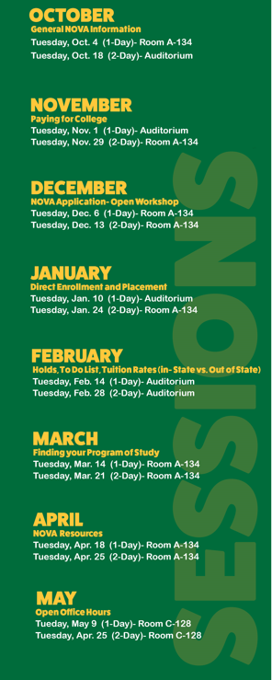
December: NOVA Application
Please make sure that you know the following information in order to complete the NOVA application:
Full legal name as it appears on government documentation
Social Security Number, if applicable
You must include your SSN if applying for financial aid
ATTN: Students with Permanent Resident Status
If you or your parents hold a permanent resident or green card, you MUST provide that number on your NOVA application. Please have that number with you when applying.
Amanda Wilder awilder@nvcc.edu

