Slide 1
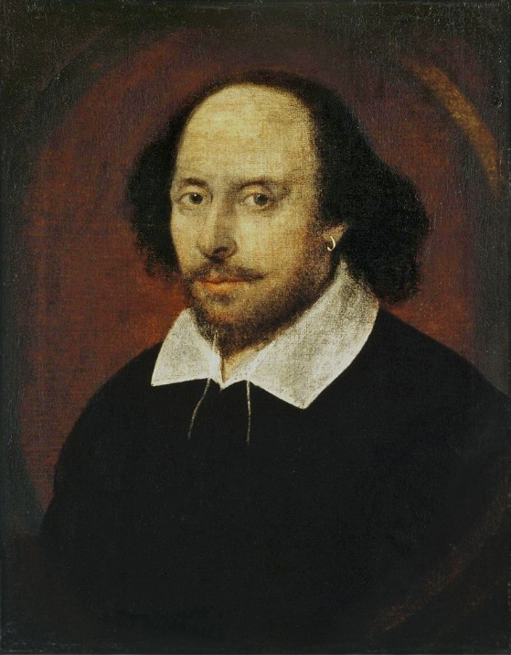
Shakespeare Background Research
English 10 Capaldi/Coles-Mathis
Notes:
Presentation slide for courses, classes, lectures et al.

Slide 2
Topics for Research
Shakespeare’s Biography
Elizabethan Time Period
The Globe Theatre
Shakespearean Language: iambic pentameter, puns, Elizabethan English etc…
Notes:
Beginning course details and/or books/materials needed for a class/project.

Slide 3
Requirements
Research | Presentation | Steps for Completion | Dates
1 book | Groups: 3-4 students | 1. Research | 11/14-16: Research
1 scholarly article | Group participation in all aspects | 2. MLA Annotated Bibliography | 11/18-22 Presentation/Notes
3 additional sources |  | 3. Presentation (ppt, prezi, etc…)
 |  | 4. Presentation to class
Notes:
A schedule design for optional periods of time/objectives.

Slide 4
APS Online Resources To access this information, go to the WHS Library Website and click on Databases and Online Resources. From Home: use your One Login; Gale PW: va_schools
GALE Databases
Biography In Context
Lit Resource Center
Virtual Reference Library – Literature- Drama for Students
World History in Context
Notes:
Introductory notes.

Slide 5
Helpful Websites
BBC History
British Library
Folger Shakespeare Library
Globe Theatre
Notes:
Objectives for instruction and expected results and/or skills developed from learning.

